Slide 1

Bird is the Word
Kevin Phillips, Jarod Hoffman, Jill Cowan

Slide 2
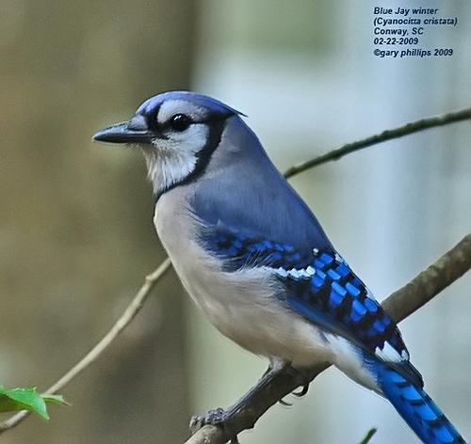
Summary
Model build
Application construction
Lessons learned

Slide 3
Model Build Data Source and Technique
Caltech-UCSD Birds-200-2011 dataset- 200 categories (classes), 11,788 images
Used Keras and Convnet (Convolutional Neural Networks) to train a small network from scratch
Divided dataset into Training and Validation sets
Wah C., Branson S., Welinder P., Perona P., Belongie S. “The Caltech-UCSD Birds-200-2011 Dataset.” Computation & Neural Systems Technical Report, CNS-TR-2011-001.

Slide 4
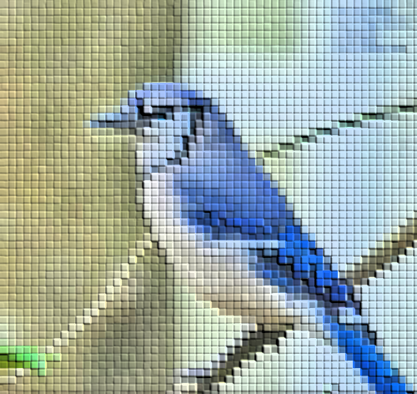
Model Build Results
Model build attempted several times
1st attempt- training set 1000 images, validation set 400 images, 50 epochs, 6 hr runtime
2nd attempt- training set ~6000 images, validation set ~6000 images, 25 epochs,18 hr runtime
3rd attempt- training set 1000 images, validation set 400 images, 50 epochs, 36 hr runtime -adjusted data pre-processing parameters with the hopes of increasing training & validation accuracy
Best training accuracy achieved was ~30%; validation accuracy was 4.5%

Slide 5
VGG16 Pre-trained Model
VGG16 is a convolutional neural network consisting of 16-layers of very small ( 3 × 3) convolution filters
Proposed and constructed by Karen Simonyan & Andrew Zisserman at Oxford
The model achieves 92.7% top-5 test accuracy in ImageNet; a dataset of over 14 million images belonging to 1000 classes
VGG16 was trained for weeks using 4 NVIDIA Titan Black GPUs

Slide 6
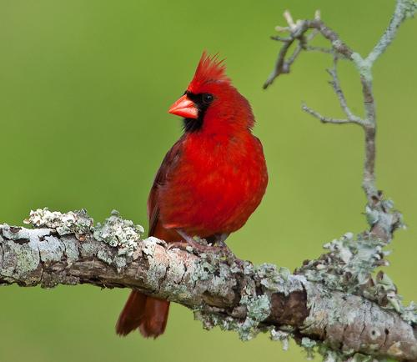
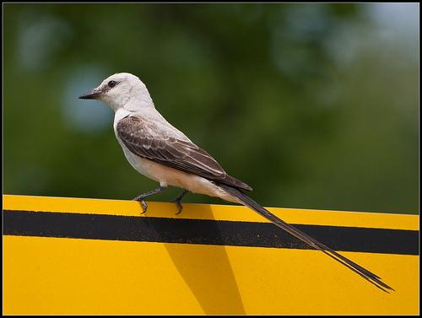
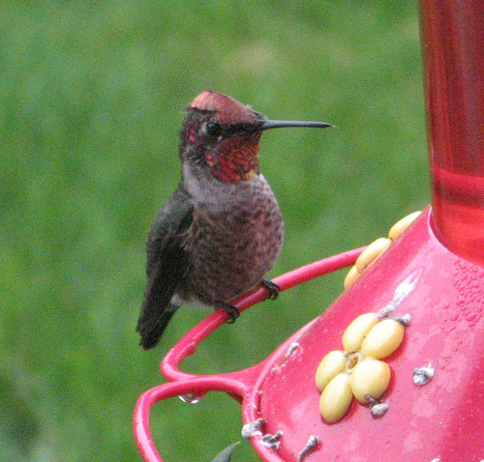
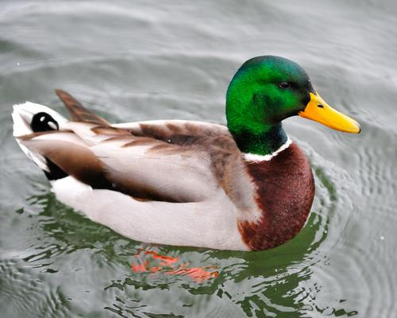
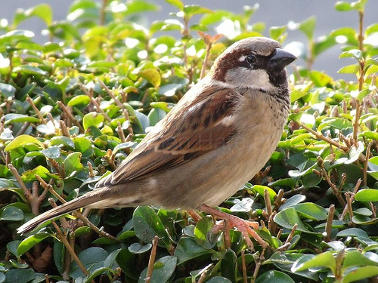
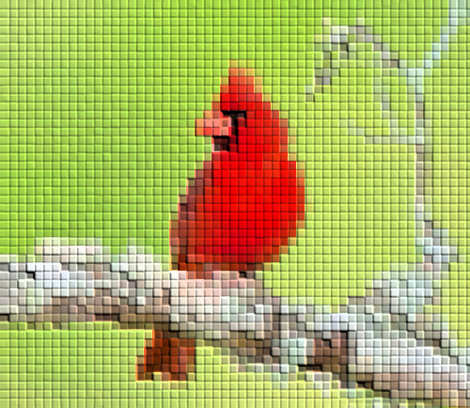
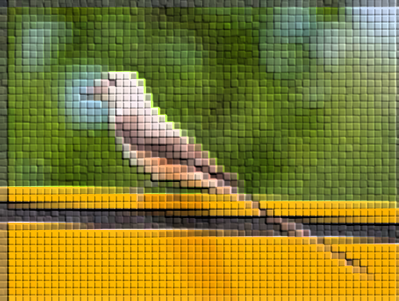
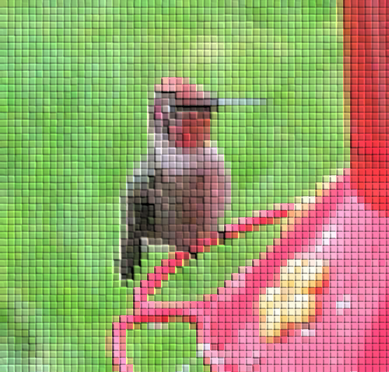
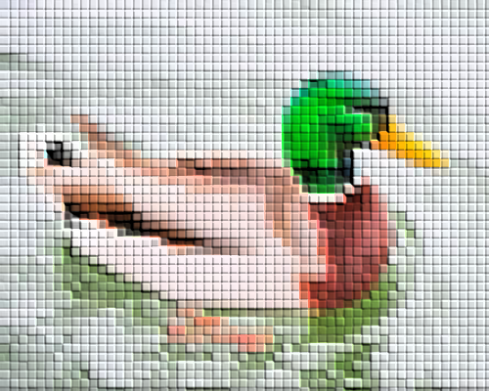
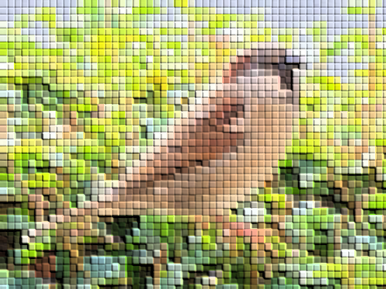
Our model vs. VGG16 pre-trained model
predictions
Bird | Our model | VGG16
Cardinal | No | No
BlueJay | No | Yes
Scissor-tailed flycatcher | Yes | No
Hummingbird | No | Yes
Mallard | No | Yes
House Sparrow | No | No

Slide 7
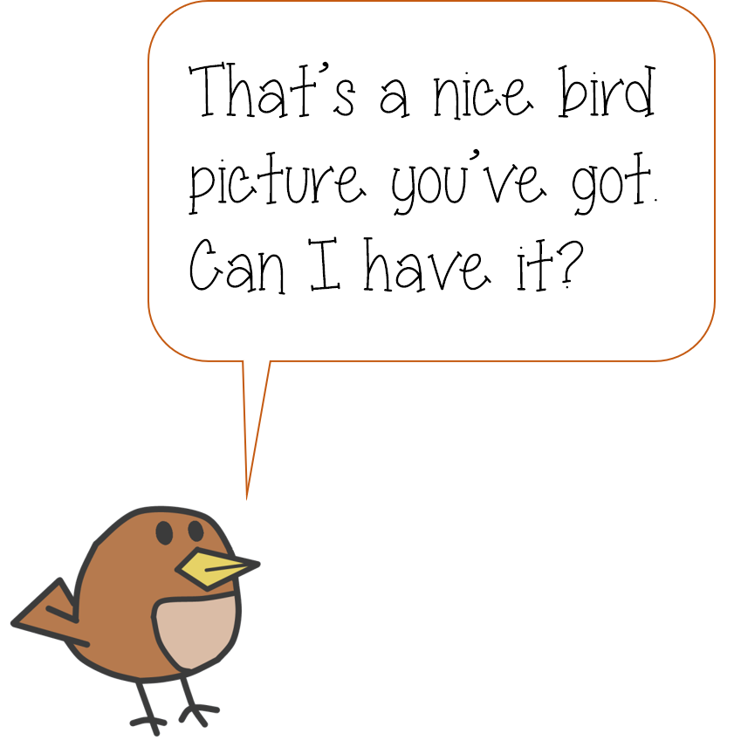
Application Construction
User inputs image
Image prediction with model
Output image class name
Scrape wikipedia for bird facts
Display bird facts for user

Slide 8
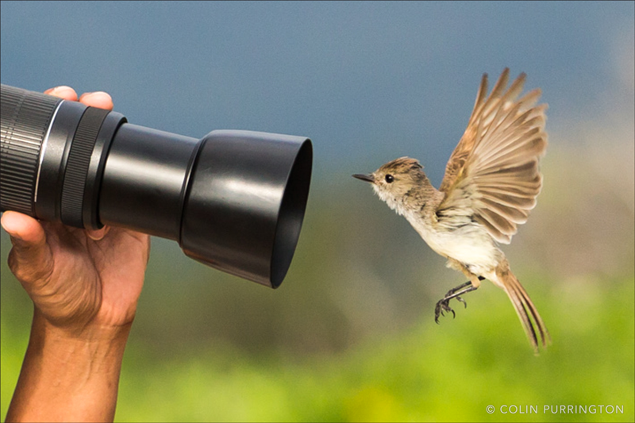
Application Construction Loading the user image
User selects an image
Image is uploaded to flask
Image is run through the model
The model output is then used to scrape wikipedia

Slide 9
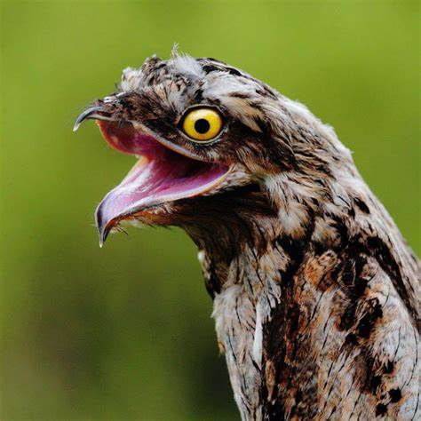
DEMO

Slide 10
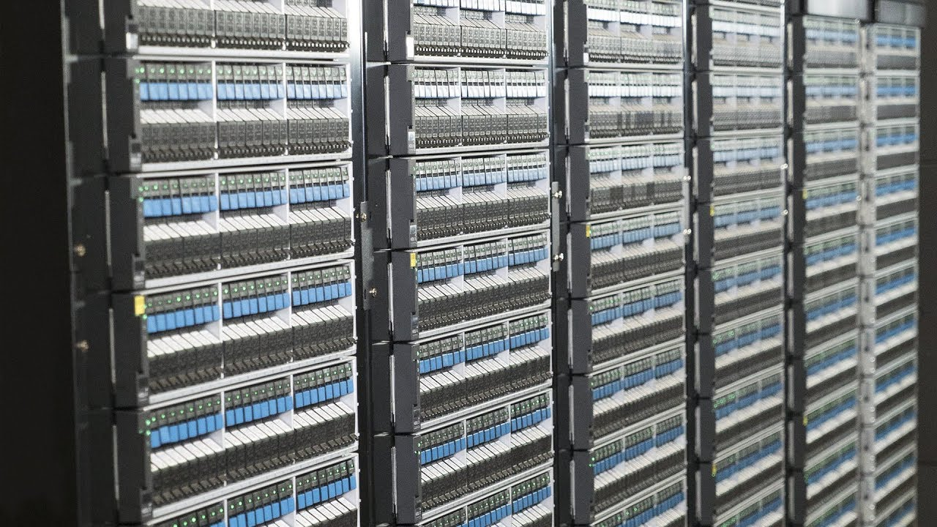
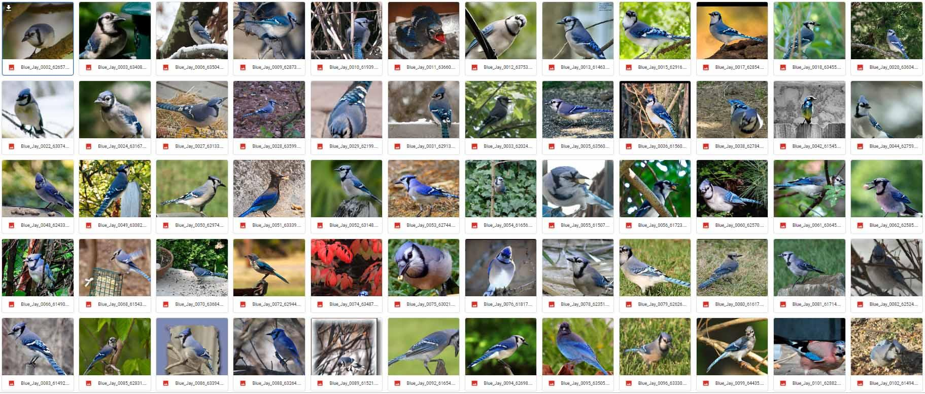
Lessons Learned: Storage
Image recognition requires photos and lots of them
Storage solution – Google Drive 15GB free storage
Image recognition models can get large
Ours ended up being around 9MB

Slide 11

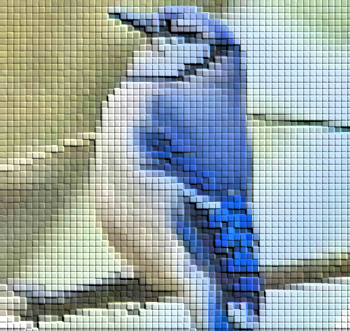
Lessons Learned: Training Tricks
In most cases, people assume a model must be trained with a huge amount of data; however, using Keras image recognition, there are a number of tricks that allow you to train with a small data set
ImageDataGenerator – Allows the model to “see” the image in different ways, effectively making a single image appear as multiple images based on rotation, shifts, and other options
Image Size – This is your scaling parameter. The larger you go, the more pixels you train for the model
Too big can lead to very large saved models and increases model creation time
Too small and your model will not be able to differentiate between the images
We used 150x150. VGG16 uses 224x224

Slide 12
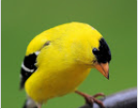
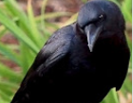
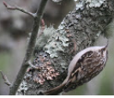
Lessons Learned: Model Building Challenges
Bird size is not readily apparent from a photo
Size of a bird is one of the most important factors differentiating bird species
Even shape is not readily apparent from many photos, birds use their colors to camouflage themselves and this can trick image recognition
Time to train models
Our models took 6-36 hours to build
Image modeling requires good graphics cards
Our most accurate model stabilized at 4.5% validation accuracy, run on a desktop with GeForce GTX 1070.
The same code run on a laptop stabilized at 0% validation accuracy, GeForce GTX 960M
The large number of categories, combined with the small number of differentiating factors between them and the small sample size, were the primary contributors to the low accuracy rate

Slide 13
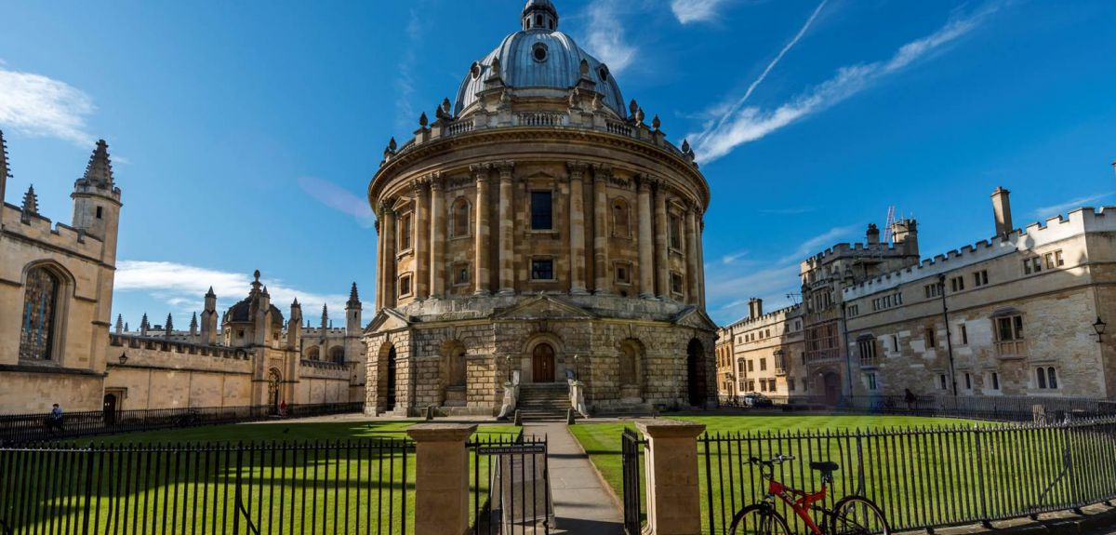
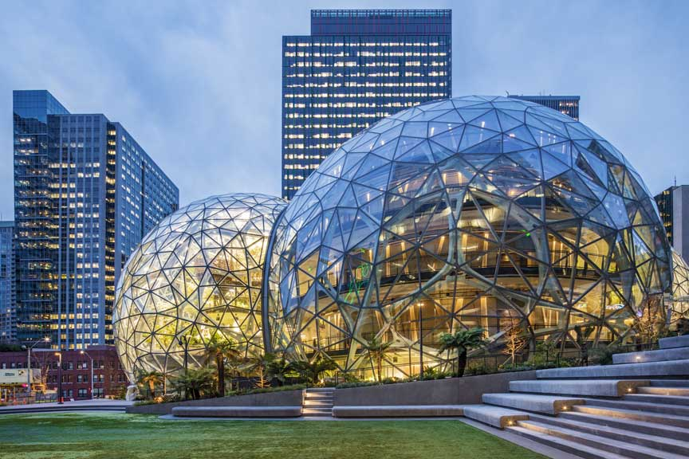
Lessons Learned: Prebuilt Model
There are a number of image recognition prebuilt models
Pro’s
These models are typically very accurate and overcome the training hurdles
Time, compute power, finding/storing source images, high end graphics cards
Con’s
These models may not have all your categories (in our case, bird names) and may require training augmentation
Many cost money to use
Examples
VGG16
While quoted to have very high accuracy misidentified cardinal as a house finch
Amazon SageMaker, AWS Deep Lens
Pay wall to leverage

Slide 14
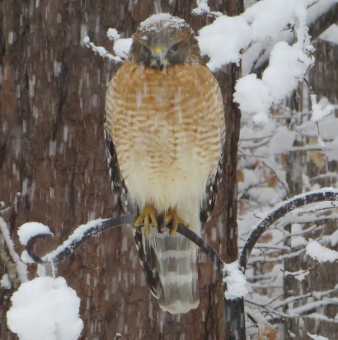
Where do we go from here?
The website code makes it fairly easy to plug in new models as we improve our model or swap out our model for a pre-trained model
The skeleton of the site could be used for other less specific image recognition models

